Slide 1
Application of numerical integration in stress-strain curve
Submitted by-
Sumit Kr. Maheshwari Sweta Kumari

Slide 2
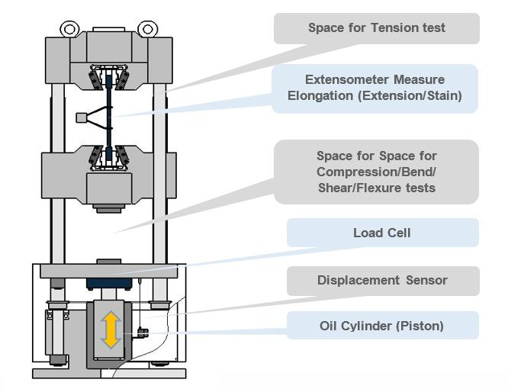
Objective-
To calculate the modulus of toughness of a material by calculating the area under the stress-strain curve .
Data for this purpose is taken from Universal Testing machine of our institute.

Slide 3
Modulus of Toughness
Modulus of toughness quantifies the toughness. It is the area under the stress-strain curve upto fracture point. It can also be defined as the strain energy stored per unit volume of the material upto fracture.
​
Ductile material can take more strain upto the fracture point than the brittle material
Mild steel is tougher than Cast iron because of this reason

Slide 4
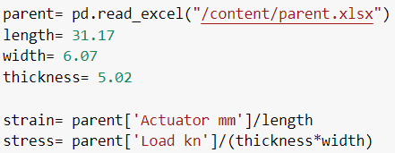
Methodology-
The dataset we got from the UTM of our institute contains the data of dynamic load applied (KN), Extension in the sample piece when the load is applied(mm) and time(sec).
The data needs to be modified to obtain the value of stress and strain using the physical laws.
The physical laws used are as follows:
Stress= Force / Area
Strain= Extension length / natural length

Slide 5
Modified dataset is now used to to calculate the modulus of toughness using numerical integration.
As the data is taken in interval of time the intervals in the strain values is not same and hence we can not use simpson rule easily.
To numerically integrate for finding the area we have used simpson rule for some parts which have same interval and trapezoidal rule for remaining parts with unequal intervals.

Slide 6
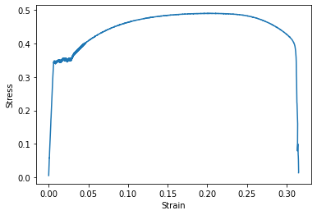
Stress - Strain graph obtained from dataset

Slide 7
code for integration using both trapezoidal and combination of Simpson’s rule
import pandas as pd
df=pd.read_excel("/content/drive/MyDrive/modified data.xlsx")
Strain = list(df['Strain '])
Stress = list(df['Stress'])
x= Strain[0:5891]
y= Stress[0:5891]
def Trap(h,f,g):
Trap = h *(f+g)/2
return Trap
def Simp13(h,f,g,i):
return h*(f+4*g+i)/6
def Simp38(h,f,g,i,j):
return h*(f+3*(g+i)+j)/8

Slide 8
def Uneven (n,x,y):
sum = 0
for j in range(n-1):
hf = x[j]-x[j-1]; ht=x[j-2]-x[j-3];hg=x[j-1]-x[j-2];
sum=sum+Trap(x[1]-x[0],y[1],y[0])
if(hf==hg ):
sum=sum+Simp13(x[j]-x[j-2],y[j],y[j-1],y[j-2])
elif(hf==hg and hg==ht):
sum=sum+Simp38(x[j]-x[j-3],y[j],y[j-1],y[j-2],y[j-3])
else:
sum = sum + Trap(x[j]-x[j-1],y[j],y[j-1])
print("Toughness of material=",sum)

Slide 9
Code for integration using trapezoidal rule
def Trapun (x, y, n)
sum = 0
for i in range (1,n):
sum = sum + (x[i]- x[i-1])*(y[i-1] + y[i])/2
print("Toughness of material=",sum)

Slide 10
Result and discussion
After feeding the modified dataset we get the modulus of toughness to be around 181 MPa .
The sample which was taken to conduct the experiment was of mild steel.
The approx. real value of toughness of mild steel is around 190-200 MPa.

Slide 11
Limitations-
The efficiency of the model reduces when less no. of points are taken in the dataset or dataset is small.
Data with large interval in the consecutive points is not favourable for this model.
This model can not calculate the error.

Slide 12
Future scope of improvement
This model can be converted into a website to calculate the toughness modulus.
Additional feature of predicting the material on the basis of toughness modulus calculated from the dataset fed into the model can be introduced.
A feature of comparing the toughness modulus of two different dataset can also be included.

Slide 13
Thank you

